Slide 1
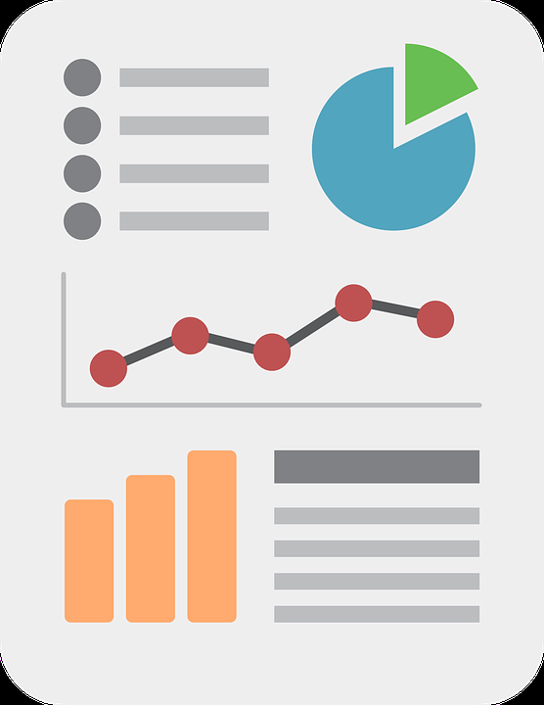
Digital Applications for Accessing Data

Slide 2
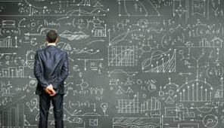
Types of Solutions for Displaying Data
Basic tools used to visually present data

Slide 3

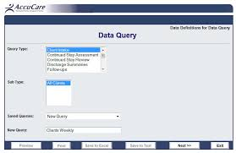
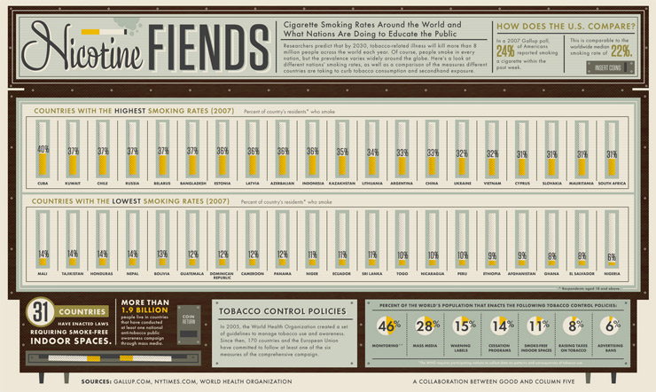
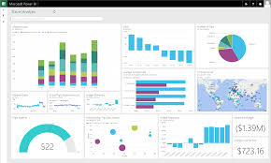
Data Portals
Stand Alone Visualizations
Dashboards
Infographics
Data Display Solutions

Slide 4
LESS COMPLEX MORE COMPLEX
STATIC
Stand Alone Visualizations
Infographics
INTER-ACTIVE
Data Access
Portals
Dashboards
Data Display Solutions

Slide 5
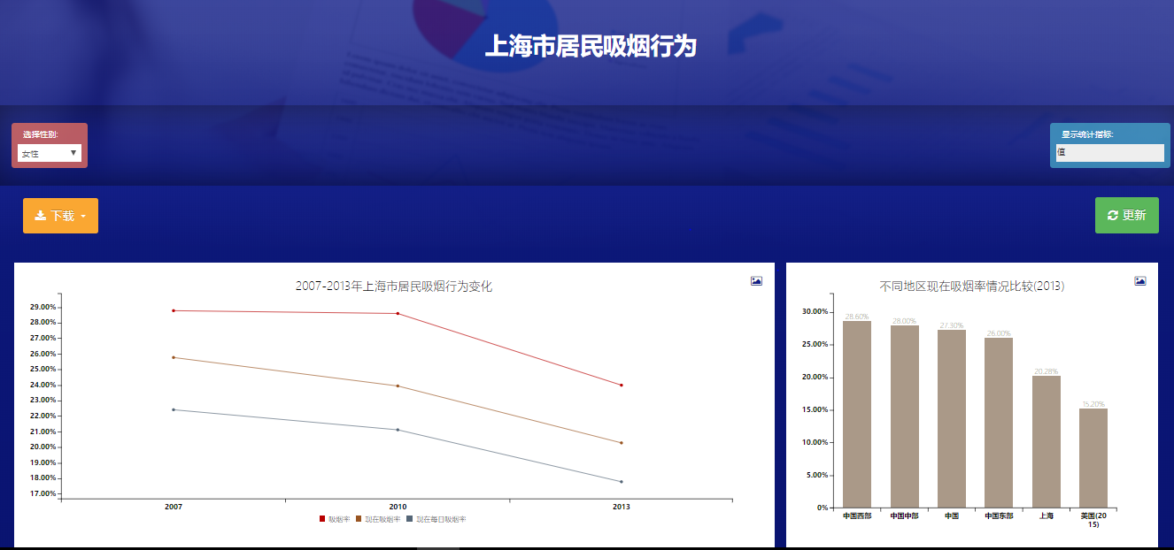
Portals and Dashboards
Providing user controls to access and explore specific data series.

Slide 6

User controls in portals
Metric Selection
Filter
Drill-down
person
place
time
sub-groups
sub-areas
shorter time periods

Slide 7
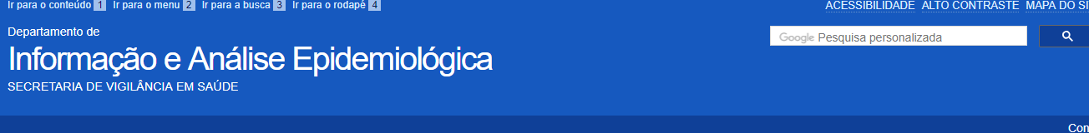
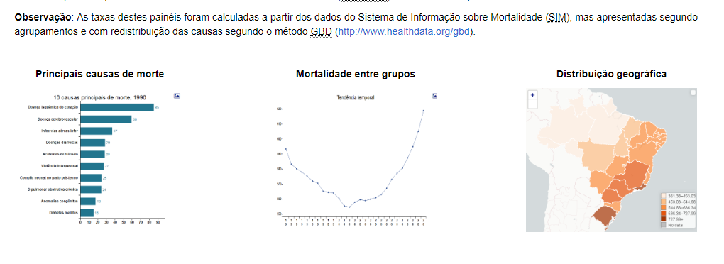
Access Portal – Mortality Data [Brazil]

Slide 8

General
Dashboard Functionality
Description
What is the situation here today?
Change
How has the situation here change over time?
Projection
How is the situation likely to change in the future?
Comparison
Is the situation here today better or worse than in other places? And Is the situation the same across all parts of “here”?
Explanation
What additional information can provide a deeper understanding for why the situation has changed?
Prediction
Who is likely to have positive/negative impact in the future?

